Slide 1
Strategies and Resources for Policy Advocacy Education Deans for Justice & Equity 2023 Summer Conference Lynn M. Gangone EdD CAE AACTE President & CEO August 11, 2023
Notes:
I want to thank the EDJE leadership for inviting me to be a part of your summer meeting—there are many AACTE members in the room, including past and current board members, and I am grateful to them for their engagement and dedication.

Slide 2
Presentation Learning Goals
What is advocacy and why does it matter?
Examples of AACTE’s advocacy work groups, and tools
Application of advocacy work to use combatting education gag orders
Notes:
AACTE members list our advocacy work as their number 1 member benefit. Today I will review what advocacy is and isn’t, and why it matters. I will give you examples of AACTE’s advocacy tools, some of which can be used by member institutions or replicated by EDJE. And then I would like to take what you learned from you last session on censorship legislation and efforts and apply those learnings to advocacy that EDJE can engage in . . .

Slide 3
From the University Undergraduate Research Council
Notes:
Let’s start with some definitions:
Lobbying as an activity that involves direct attempts to influence specific legislation or government policies.
Advocacy involves promoting a specific cause or issue, raising awareness, and educating the public or policymakers about a particular topic.
Note: There are some rules governing lobbying efforts for 501(c)(3) organizations. I am not sure if EDJE is a 501 C-3 but AACTE is. As such, there are limits to how much time and human/fiscal resources the association can devote to this work. Additionally, AACTE must remain non-partisan. The association can support or oppose legislation but not based on identifying specific party affiliations
.
EDJE is an organization that can focus on advocacy.
Overall, there are three key aspects to remember:
Advocacy is organized action in support of an idea or cause
advocacy is constituents educating elected officials or other stakeholders on important issues, and
advocacy is establishing ongoing and trusting relationships.
Why does advocacy matter? It is using our voices as committed and informed champions for our mission. It is about relationship building and becoming a trusted source to ensure our priorities are heard, our communities are represented, and that good ideas are funded/supported.
QUESTION: Who is the strongest voice of your message?

Slide 4
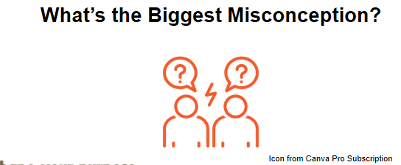
From the University Undergraduate Research Council
Notes:
One of the biggest misconceptions about advocacy is the belief that advocacy is limited to traditional lobbying activities or that it requires direct engagement with policymakers only. This misconception can lead to underutilization of advocacy strategies and missed opportunities to advance the association's goals.
The reality is that advocacy encompasses a much broader range of activities beyond direct lobbying and can be a powerful tool for associations to achieve their objectives. Some common misconceptions you might hear or have heard include:
Advocacy Is Only Lobbying: While lobbying is a specific form of advocacy that involves direct engagement with policymakers to influence legislation, advocacy itself is much more diverse. It includes activities such as public education campaigns, media outreach, grassroots mobilization, coalition building, and raising awareness about issues related to the association's mission.
Advocacy Is Not for Us: Some association members may believe that advocacy is solely for large organizations or well-established groups. In reality, advocacy can be effective for associations of all sizes and across various industries or causes. Even smaller associations can have a significant impact through strategic advocacy efforts.
Advocacy Is Too Political: There might be a misconception that advocacy involves partisan politics or taking a stance on controversial issues. While some advocacy efforts may be related to policy matters, associations can focus on nonpartisan advocacy to advance their mission without getting entangled in partisan debates.
Advocacy Is Resource-Intensive: Some association members might view advocacy as a resource-intensive endeavor that requires significant financial investment and staff time. While advocacy efforts do require planning and resources, they can be tailored to suit the association's capacity and budget.
Advocacy Is a One-Time Effort: Advocacy is an ongoing process rather than a one-time event. Building relationships with policymakers and stakeholders, educating the public, and advocating for change often require sustained efforts over time.
Our Members Are Not Interested in Advocacy or Don’t Feel They Can Do Advocacy: There might be a misconception that association members are not interested in advocacy or that advocacy is not relevant to their concerns. In reality, many members are likely to be passionate about issues affecting their industry or profession and may be supportive of advocacy initiatives.
Overcoming these misconceptions requires education and communication within the association. Association leaders and advocates can take steps to demystify advocacy, highlight its diverse forms, and demonstrate its potential to bring about positive change. By promoting a clear understanding of advocacy and its benefits, associations can effectively engage their members in advocacy efforts that align with their mission and contribute to the collective success of the organization. Anyone can share your value and the mission of your organization and the impact. It’s if they are given the right tools, how will they use them.

Slide 5
From the University Undergraduate Research Council
Notes:
What are some roadblocks that hinder advocacy within your association/organization? Some roadblocks we have had to consider include:
Political environment: Shifting priorities, government shutdowns, difficulty getting on agendas
Lack of awareness: Some of our association members did not fully understand the importance and impact of advocacy efforts or how to participate
Resource constraints: We are a small organization and have limited time within our organization
Lack of focus: We did not have an overall strategy or combined efforts so some of our programs were suffering from scope creep.
Not speaking in kitchen-table terms: this is the curse of many of us in the academy. We have to make our message clear and concise, in language the general public can understand
Two examples: NWSA, Hunt-Kean Fellows

Slide 6
Question?
What are some misconceptions that you have or roadblocks you have encountered inside your work in EDJE and/or your institutions?
Notes:
Break up into groups of five to discuss the following question, I will give you around five minutes, and then we’ll do a quick reporting out.

Slide 7
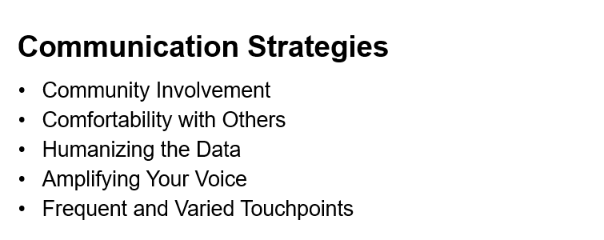
From the University Undergraduate Research Council
Notes:
Community Involvement: Engage with committees, colleagues, and other stakeholders to build a supportive community around your advocacy causes. In our case, we had to update and inform multiple committees and our board of directors so they could become ambassadors for our newly envisioned program. Also consider providing training and resource materials for your community.
Comfortability with Others: Foster authentic relationships beyond staff members to create a sense of trust and camaraderie within the community. We often have students who express concern when approaching legislators or other “authorities” because they don’t feel they are on equal footing or don’t know how to approach them. We tried to create opportunities to practice in our trainings in order to build confidence and also made sure to emphasize that each person has an important story to tell and that part of the job of people like government/state legislators, funding agencies, etc. is to hear from constituents.
Humanizing the Data: Go beyond presenting research and numbers; showcase how the research impacts individuals personally to give it more life and relevance.
Amplifying Your Voice: Combine efforts and collaborate with other societies or groups to have a more significant impact on advocacy goals. Avoid working in isolation and seek opportunities for partnerships and alliances to expand the reach and influence of the advocacy message.
Frequent and Varied Touchpoints: Emphasize the need for year-round advocacy efforts instead of a "one and done" approach. Leverage a variety of communication channels.

Slide 8
Can you think of other communication tactics you might use for an advocacy program?

Slide 9
AACTE (501 C-3) Advocacy Work
FEDERAL
STATE
CONGRESS
FEDERAL OFFICES
AACTE STAFF
DAY ON THE HILL
“HOME” VISITS
TOOL KITS
STATE LEGISLATURES
STATE AGENCIES
ACSR/STATE AFFILIATES
STATE DAYS

Slide 10
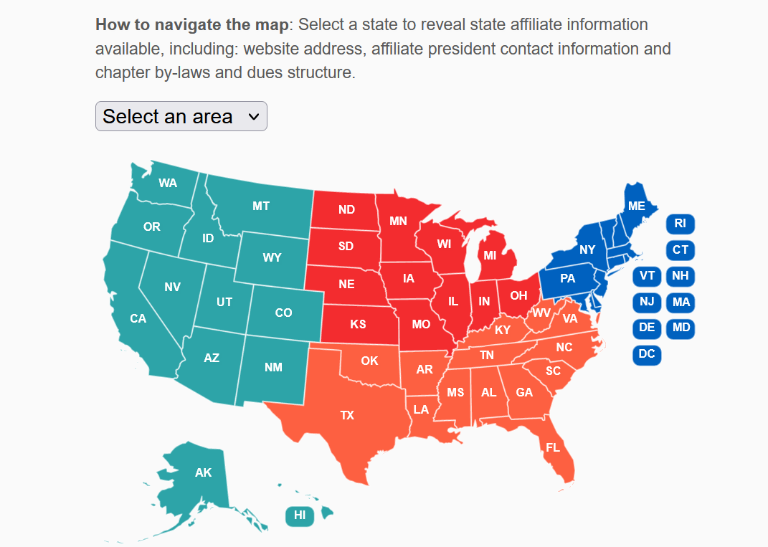

Slide 11
Notes:
To add to Christine Sleeter and Z-Nicolazzo’s presentation I am going to add to their maps of anti-CRT and anti-trans legislation. The next slides are from PEN America, and AACTE is founding member of the Freedom to Learn Coalition co-led by PEN America, Lumina Foundation, and the American Council on Education –ACE.

Slide 12
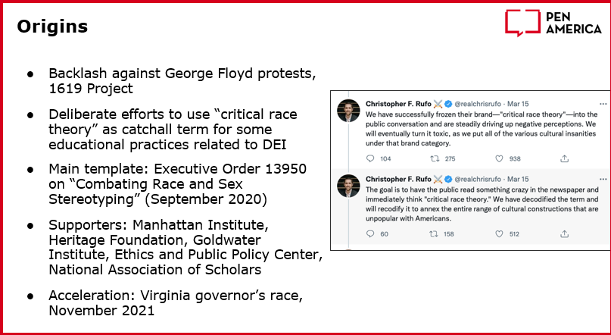
https://www.greenpeace.org/usa/democracy/the-lewis-powell-memo-a-corporate-blueprint-to-dominate-democracy/
Notes:
I would amend this slightly to say that the origins of the movement to censor started with the Written in 1971 to the U.S. Chamber of Commerce, the Lewis Powell Memo was a blueprint for corporate domination of American Democracy.

Slide 13
Notes:
We’ve discussed some of these already

Slide 15
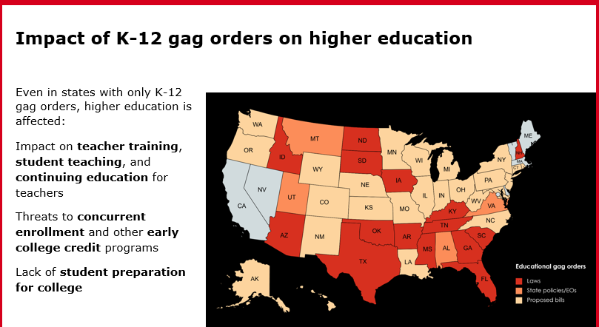

Slide 17
Notes:
Also yesterday’s article in the Wall St. Journal that lays out exorbitant costs public higher education institution have made in what the paper considers frivolous investments, debunking the claim that increased tuition costs are the fault of state cuts.

Slide 18
Notes:
Here’s examples of written advocacy—also there are groups of university president, governing boards, and others convening to fight the good fight here

Slide 20
EDJE AND ADVOCACY
Please break up into
groups of five to discuss
three strategies for advocacy
you’d recommend for
EDJE moving forward.
Notes:
Given the conversations you’ve been having, and the strategies described, please now spend the last few minutes identifying THREE advocacy strategies you believe EDJE can and could engage in immeediately

Slide 21
Questions?

