Slide 1
National landscape of censorship legislation…
…and efforts to push back
Z Nicolazzo, Ph.D.
Associate Professor, Trans* Studies in Education
University of Arizona

Slide 2
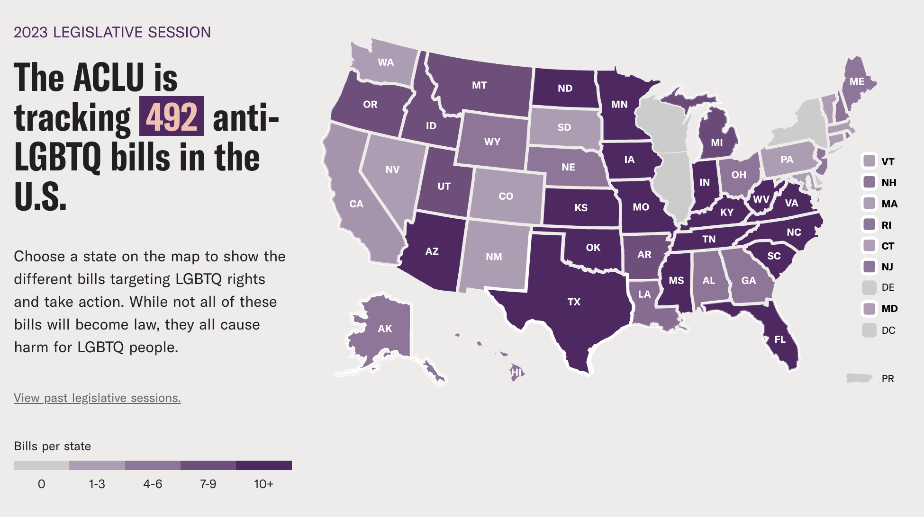
Anti-trans(Girl) legislation
Heavily focused on schools/schooling environments, which is significant given our roles in this very context.
Deeply connected to ongoing enactments of anti-blackness and misogyny.
Largely focused on regulating the movements trans girls and women, especially trans girls and women of color.

Slide 3
Detailing the institutional problem
“The material conditions of transmisogyny that frame our individual and collective (non-)existence as trans girls and women is a rather quotidian fact of life. While this does not dull its material edge, it does bear repeating that it is not unusual or otherwise remarkable in its omnipresence. …[W]hen someone falsely presupposes transmisogyny to be ‘new’ or ‘unbelievable,’ they are participating in the reproduction of a world that views trans women as ‘new’ or ‘unbelievable,’ which is to say, they are furthering ideologies that frame trans women of out view (epistemologically, ontologically, and otherwise). To know trans women exist is to know transmisogyny mediates and curtails our life chances.”
~The Demands on Trans Women

Slide 4
How does this show up in our work?
Hiring/seeking to hire trans people without doing the preparatory and/or ongoing work to support us.
Desiring transness as a form of ‘tickbox diversity’ (Ahmed, 2012).
Having ‘perfectly logical explanations’ for why trans-affirming praxis cannot happen (e.g., “I wish we could do x, but…”
Assuming trans hires will ‘fix’ all other faculty/staffs lack of trans knowledge.
Not having ongoing relationships with queer and trans organizations (local and/or in your field/through the academy).
Engaging in isomorphic practices and, as a result, not hiring trans people because other people have yet to.

Slide 5
This is not a ‘right’ v. ‘left’ issue…
(or perhaps it is in the sense that those on both the ‘right’ and ‘left’ participate in furthering the sociopolitical conditions through which trans people live)

Slide 6
What can education deans do to forward trans justice and equity?
BEFORE
Do some internal auditing work to address where you are in supporting trans faculty/staff/students.
What is the status of trans healthcare on your campus?
Are there single-stall, lockable restrooms in your building? Are there multi-stall gender-inclusive restrooms?
Are there queer/trans affinity groups on campus for faculty/staff/students?
Do you have ongoing, meaningful connections with local queer/trans organizations?
Do faculty’s proper names show up on digital rosters (or is it just legal names)?
With which queer/trans professional organizations/associations/affinity spaces are you connected?
Do you have other trans faculty/staff/students in your college?
Do nontrans faculty/staff use trans-centered knowledges through their practice?
Begin having conversations with various on- and off-campus stakeholders about your commitment to trans livability.

Slide 7
What can education deans do to forward trans justice and equity?
DURING*
Provide queer/trans-affirming and centered mentorship to new hires (regardless of rank/experience).
Be aware of what is happening locally and globally for trans people (e.g., do you know the bills being proposed/passed in your state legislature from the map on the second slide in this presentation?).
Be taking in trans-centered knowledges yourself (note: trans-centered is different from knowledges about trans people).
Be proactive in addressing concerns...and also, celebrate successes (both of which require practices of noticing).
Do not minimize trans faculty/staffs' experiences of anxiety and fear in/out of the classroom.
Use trans of color epistemes in addressing concerns (e.g., many of us do not feel safe with police).
Do not assume all trans people are the same.
Be transparent, up front, and clear about your mistakes and missteps.
If you are not ready, or if your organization is not ready, then please do not seek to specifically hire trans people (i.e., don’t create a named job if you are not prepared to support the person(s)).
Check in with trans faculty/staff on an ongoing basis to learn from them what sort of supports they may need or want.
Be ready to support trans-led, centered, and focused research (especially in this sociopolitical climate).
Structure evaluative processes in manners that recognize trans-centered approaches to life and work.
Continue having conversations with various on- and off-campus stakeholders about your commitment to trans livability.

Slide 8
What can education deans do to forward trans justice and equity?
AFTER
Hold exit interviews with trans faculty/staff who choose to leave your college.
Recognize and act on the connectedness of oppressive ideologies and systems.
A vital part of this is taking a ‘trickle up’ approach to educational praxis (Nicolazzo, 2017; Spade, 2015)
Do not stop at one (person, class, program, session, …).
Recognize limitations exist, but do not use those limitations as reasons to not act (e.g., trans-affirmative healthcare is a perfect example).
Do some self-reflection on what you could have done differently to set up your environment differently/better for the person who is leaving.
Continue having conversations with various on- and off-campus stakeholders about your commitment to trans livability.

Slide 9
Joy is crucial for social change; joy is crucial for teaching. Finding joy in the midst of pain and trauma is the fight to be fully human. A revolutionary spirit that embraces joy, self-care, and love is moving toward wholeness. Acknowledging joy is to make yourself aware of your humanity, creativity, self-determination, power, and ability to love abundantly. …We cannot freedom-dream without joy.
Bettina L. Love
We Want to Do More than Survive: Abolitionist Teaching and the Pursuit of Educational Freedom

