Slide 1
Special Issue of Professing Education
Call for Submissions
(due January 31, 2021)
Guest Co-Editors:
Dr. Kerry Soo Von Esch & Dr. Michelle Bryan
Consulting Editors:
Dr. Kevin Kumashiro, Dr. Carol Batker & Dr. Vidya Shah
Notes:
KERRY

Slide 2
Journal Information
Special issue of Educational Studies and/or Professing Education
Theme: Critical Conversations about Movement Building for Equity and Justice in Education
Advancing equity and justice in education as a form of movement building in this historical moment
Paradoxes, presumptions and promises of education as a public good and core institution in a democratic society
Vehicle to share the work of the conference with a wider audience and to keep the work moving forward
Notes:
KERRY
Professing Education [https://societyofprofessorsofeducation.wordpress.com/professing-education-journal/] is dedicating a 2021 special issue to highlight the scholarship presented at the 10th International Conference on Education and Social Justice. We invite manuscripts that further examine the conference theme of Critical Conversations about Movement Building for Equity and Justice in Education, and in particular, that develop our collective capacity to critically self-reflect, collaboratively theorize, and courageously build. What does it mean, in this historical moment, to advance equity and justice in education as a form of movement building? How do we both collectively dive into and critically examine the paradoxes, presumptions, and promises of education as a public good and a core institution in a democratic society? This special issue will be a vehicle to share the work of the conference and these conversations with a wider audience.

Slide 3
This call is for manuscripts that are based on presentations at the 10th International Conference and that have not yet been published.
Notes:
MICHELLE

Slide 4
Manuscript Submission Requirements:
4000-7000 words
12-point Times New Roman font
Double-spaced
APA-style
1-inch margins
Your contact information
One-paragraph abstract
Bibliography in the same file as the manuscript
Send to Dr. Kerry Soo Von Esch and Dr. Michelle Bryan at sjedspecialissue2021@gmail.com
Deadline: January 31, 2021
Notes:
MICHELLE

Slide 5
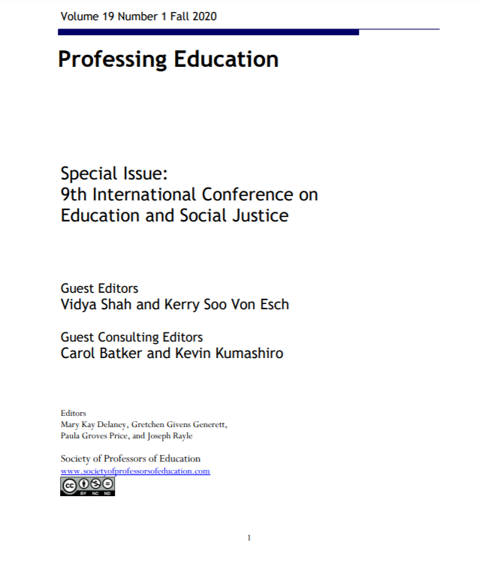
https://societyofprofessorsofeducation.com/2018/04/25/professing-education/
Notes:
KERRY
Put link in chat box?
https://societyofprofessorsofeducation.files.wordpress.com/2020/12/professing-education-19-1-fall-2020-final.pdf

Slide 6
Our Considerations as Co-Editors of the Special Issue
Multiple and contradictory criteria:
Clarity in voice
Complex, layered thinking
Push methodological and theoretical boundaries
Pedagogical/theoretical contributions
Expect several rounds of revisions for all submissions
Collective wisdom that does not silence and erase local or marginalized knowledge(s)
Notes:
KERRY
As special-issue editors, navigating this liminal space was most obvious in how we conceptualized ‘voice’ - the authors’ voices, our voices, and the collective voice. We questioned how significant, consistent, and direct edits centered our voices and values as the editors, at times minimizing the voices of the author. On the other hand, our reviewers encouraged us to reflect on how this type of feedback might further support authors in clarifying and strengthening their voices, making even stronger pedagogical contributions to our collective work. For example, how might we encourage authors to stand affirmatively in their own voices and place less emphasis on connecting their ideas and voices to established scholars in the field? We were also encouraged to reflect on how we might view each piece as part of a larger collective movement for justice in education. We worked through the ambiguity of what collective scholarship might look like that does not recenter dominant, hegemonic worldviews and approaches to editing. It would necessarily include editing from the liminal, which questions the ways in which we have normalized colonial and neoliberal logics in the editing process. Our thinking centered on these three elements:
Having high expectations across multiple and contradictory criteria, such as clarity in voice and complex, layered thinking or submissions that push the methodological and theoretical boundaries of what counts as scholarship while operating within colonial structures in the academy;
Including several rounds of revisions for all submissions, not simply those deemed ‘close to ready’ from the start. Given the multiple and contradictory criteria, each submission can benefit from further complicating ideas; and,
While each submission would benefit from the collective wisdom of authors and editors, paying close attention to how a move to collectivism may serve to silence and erase local or marginalized knowledge(s).
As we name the moment that we’re in, one in which we are grappling with decolonizing the academy and education systems that continue to operate as colonial structures, our thinking, writing and movement building must necessarily occur in the ambiguity and contested space of the liminal.

Slide 7
Tentative Timeline
Manuscripts due January 31, 2021
2 anticipated rounds of revision
Late Spring (April/May)
Late Summer (Mid-July to Mid-August)
Publication date - Fall (Sept/Oct)
Notes:
MICHELLE

Slide 8
Questions?
Please send submissions to
Dr. Kerry Soo Von Esch and Dr. Michelle Bryan
at sjedspecialissue2021@gmail.com
by January 31, 2021
Notes:
MICHELLE

