Slide 1
Adapting the EDJE Framework for Adult Learning Organizations Ted Kalmus, Director, Educational Leadership Programs, Seattle University College of Education kalmust@seattleu.edu 206.356.7971

Slide 2
Welcome
Adult Learning Organizations
Adapting the EDJE Framework
Four Transformative Organizations
Our Process & Approach: Consulting through Change
Findings & Observations
Future Opportunities

Slide 3
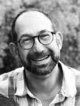
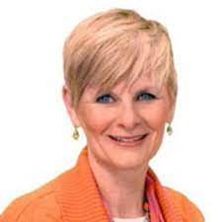
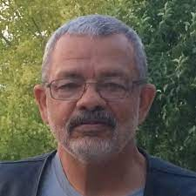
Adapting the EDJE Framework for Adult Learning Organizations
Bob Hughes, Professor Emeritus of Adult Education, Seattle University
Deanna Iceman Sands, Professor Emeritus of Leadership & Teacher Education & former Dean of the College of Education, Seattle University
Ted Kalmus, Director, Educational Administration Programs, Seattle University kalmust@seattleu.edu

Slide 4
Adult Learning Organizations: Designed for Remedy, Trailing the field
… many organizations germinated from grass roots efforts or as a funded impulse initiated by a public grant, a political crisis or the interest of a single donor.
These are origin stories full of hope and energy, but they contain the roots of many challenges faced by adult learning organizations as they mature and seek to sustain and expand their impact. (Kalmus, 2023)

Slide 5
Framework for Assessment & Transformation
Framework for Assessment and Transformation of Adult Education (FATAE)
Maintain
Theory of change
Centrality of organizational alignment
Disposition toward inquiry
Importance of organization wide participation
Adapt
Reduce language specific to higher ed context
Increase focus on organizational action
Emphasize flexibility of use
“assess and address current needs”
“engage perpetual states of change

Slide 6
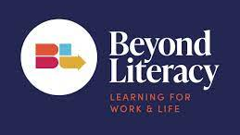
Four Transformative Organizations
Notes:
Strong Equity Proposition
Demonstrable outcomes
Expressed Interest in authentic self-reflection
Commitment by leadership
Desire to document learning by doing

Slide 7
Coaching Appreciative Inquiry
Avoid ethnographic challenges regarding voice & position
Center organizational purpose, identity, desire and process
Consult & coach through change
Reflect & synthesize

Slide 8
Findings “walking our talk”
Applying a system-wide equity framework revealed gaps in practice and policy as well as uncelebrated strengths for each organization.
Misunderstood gaps | Uncelebrated strengths
Compensation practices Staffing policies Brand integrity Trust in leadership Employee turnover | Organizational resilience Undocumented impact “quiet” partnerships Community trust Nimbleness

Slide 9
Stories of Impact Fidelity Communication Alignment Capacity Resources Leadership
When we began this project, we did not make organizational change an intentional outcome... (Hughes , 2023)

Slide 10
Final Thought
Completing this project reinforced for me the idea that centering equity is a powerful tool for organizational alignment, and that organizations that are authentically grounded in their purpose and practice are energized, magnetic and more likely to thrive (Kalmus, 2023).

Slide 11
Opportunities
Continue to refine the tool
Impact of iterative use
Possibilities of better integrating the framework with strategic planning tools

Slide 12
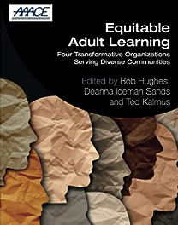
Equitable Adult Learning (2023)
https://www.routledge.com/Equitable-Adult-Learning-Four-Transformative-Organizations-Serving-Diverse/Hughes-Sands-Kalmus/p/book/9781032261881

